Slide 1
From the Ground Up: Community Organizing and Participation in Local Food Systems
Julia Reynolds
Resource Assistance for Rural Environments (RARE)
October 2015

Slide 2
Community organizing is a tool to build stronger food systems & healthier communities
Community Organizing:
The process of building a network of engaged individuals who are mobilized to reshape local systems
Notes:
-- How community organizing processes can be used to build stronger food systems & healthier communities, from 3 examples in Clackamas County

Slide 3
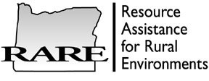
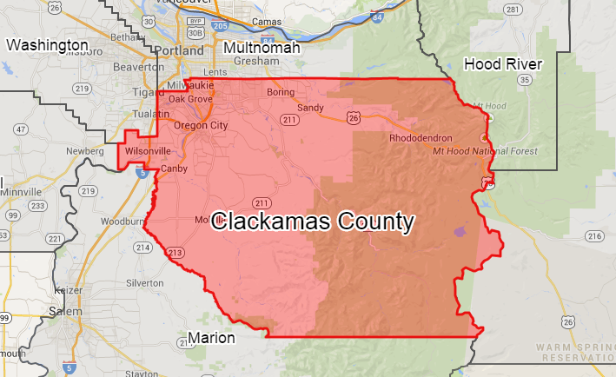
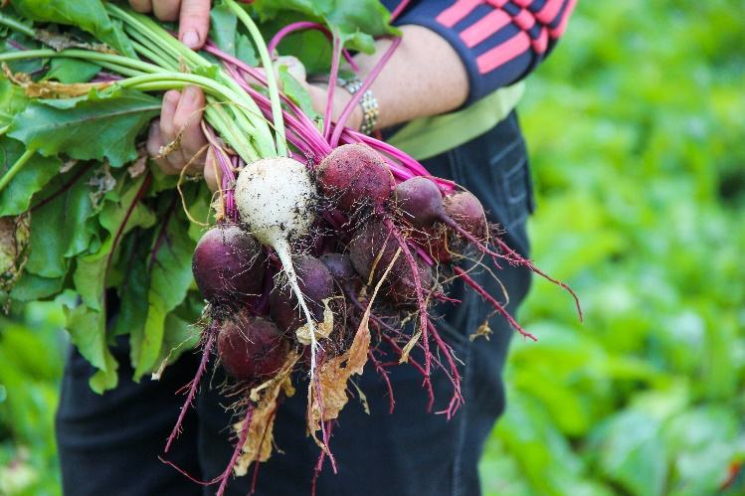
RARE AmeriCorps Partnership
19 Community Food Assessments (CFA) covering 27 counties
Reflects local food system through lens of communities
Informs grassroots actions in communities
Clackamas County CFA September 2014 – July 2015

Slide 4
Hunger in Clackamas County
USDA Food Insecurity rate 2014
United States – 14.3% Oregon – 16.1%
Map the Meal Gap 2015:
Clackamas County 12.6% rate of food insecurity
47,990 food insecure individuals
Rural areas experience higher rates of hunger, poverty

Slide 5
Community Organizing Processes
Engage & promote community ownership
Address specific assets and needs
Facilitate community partnerships & collaboration

Slide 6
Welches (population est. 2,500)
Focus groups November 2014 – January 2015
Identified specific need:
Increased availability of healthy & affordable food

Slide 7
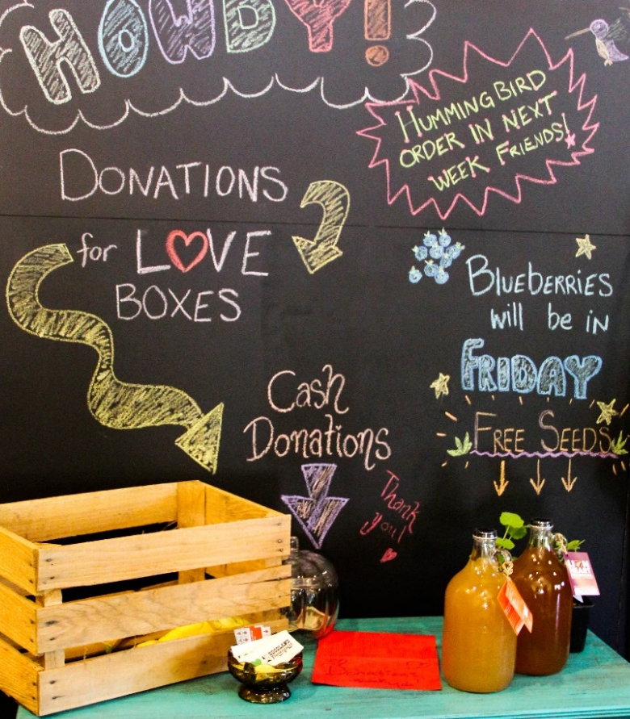
Hoodland Farmacy Buying Club
Community ownership over food system & health

Slide 8
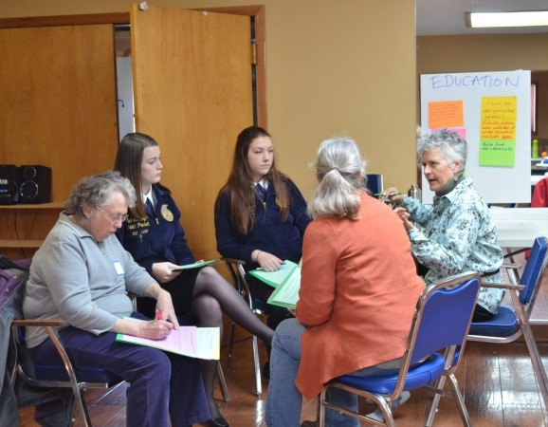
Sandy (population est. 10,000)
April 2015 FEAST Workshop
(Food – Education – Agriculture – Solutions Together)
Collective visioning:
Community food guides
Local food in restaurants, grocery stores
Working community group to build food network

Slide 9
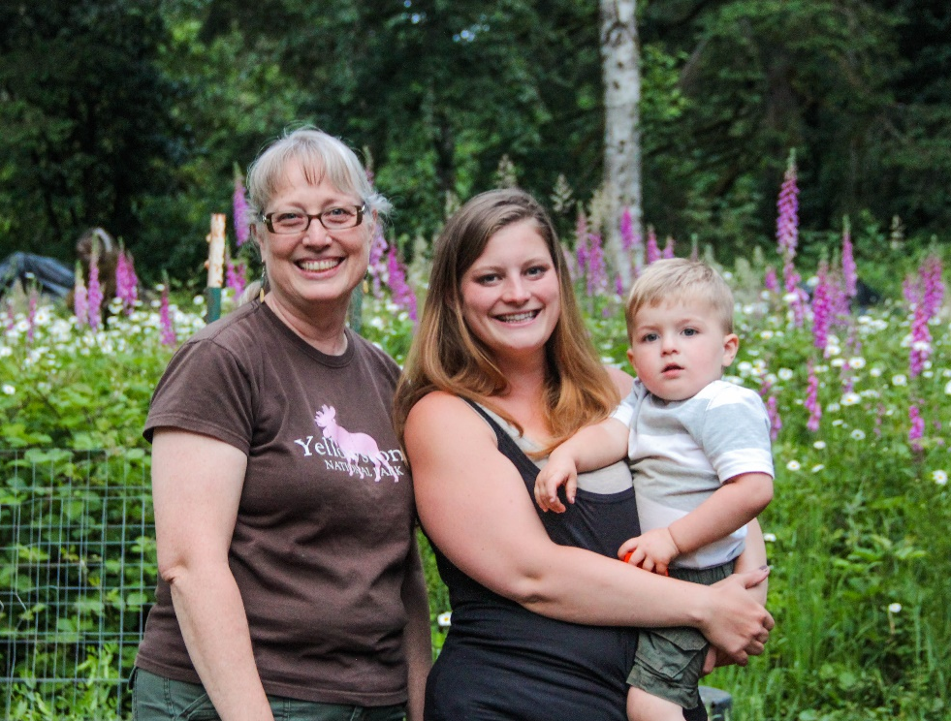
Wy’East Food Web

Slide 10
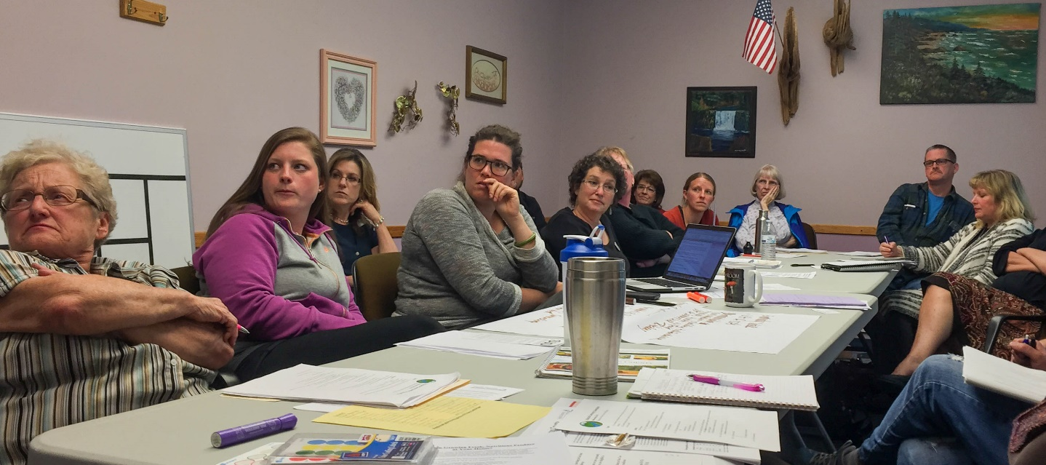
Estacada (population est. 3,000)
May 2015 Community Conversation
Facilitated local partnerships & capacity-building

Slide 11
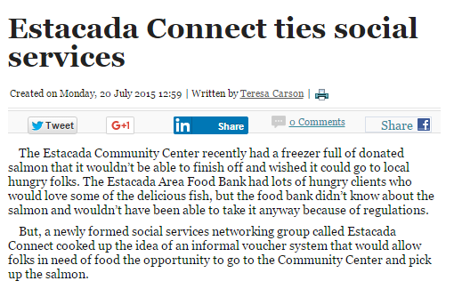

Slide 12
Challenges to Community Organizing
Maintaining energy through long-term, process-based solutions
Including diverse group of stakeholders

Slide 13
Tools & Resources
Focus Groups
FEAST Workshop & Community Conversation
www.oregonfoodbank.org/our-work/
Community Food Assessments
www.oregonfoodbank.org/our-work/
www.rare.uoregon.edu/
Julia Reynolds
reynolds.juliam@gmail.com

